Slide 1
Juneteenth
Student health & human services
Office of human relations, diversity & equity
June 2022

Slide 2
Would You Rather...
Have constant dry eyes
Have a constant runny nose

Slide 3
Objectives
Learn about Juneteenth
Discuss its Importance

Slide 4
What is Juneteenth?
Refers to June 19, 1865 when enslaved people in Texas were first made aware that they had been declared free under the terms of the 1862 Emancipation Proclamation.
Currently, it is a holiday celebrated on June 19 to commemorate the emancipation of enslaved people in the US.
The holiday was first celebrated in Texas

Slide 5
Why All Americans Should Honor Juneteenth
Notes:
7:12
https://www.youtube.com/watch?v=6FX-Iisvrj8

Slide 6
Did you know about Juneteenth?
The video posed important questions for Black people:
"How free are we?"
"Are we free?"
Do you think Black people are free?

Slide 7
The Importance of Juneteenth
In the United States, we celebrate 4th of July as our Independence Day.
As we all know, not all were free or independent.
Juneteenth is a day of freedom for all Black people in the United States and has been overlooked in US History. Yet, this is a day of celebration for our entire nation and is just as important as Independence Day.

Slide 8
In 2021, President Biden declared Juneteenth a Federal holiday.
This is the first new Federal holiday since Martin Luther King Day in 1983.
What does Juneteenth mean to America?

Slide 9
Should Juneteenth be a part of the US History curriculum?

Slide 10
Human Relations, Diversity & Equity

Slide 11
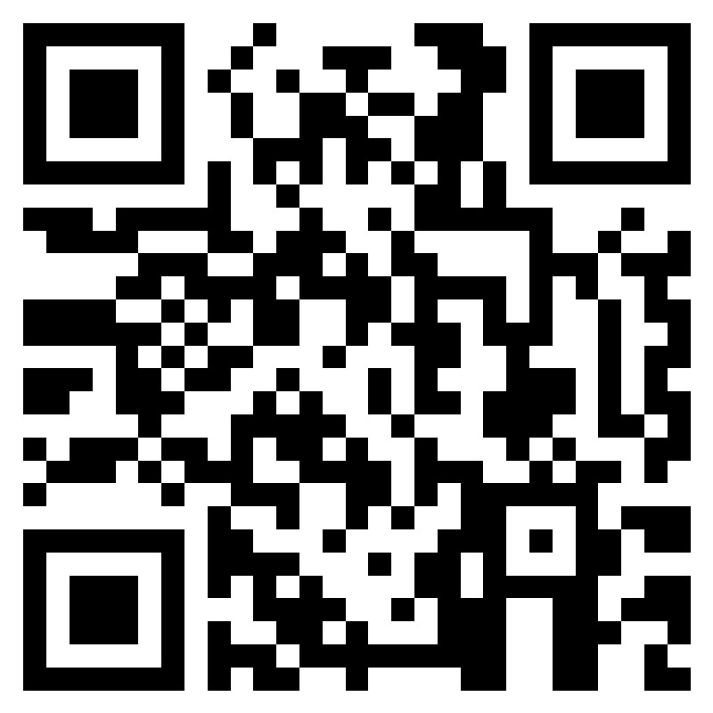
Teacher Feedback Survey
Notes:
Teacher, please scan the QR code or click the link below to complete a brief survey:
https://forms.office.com/r/i9UqyyxzTT

